Slide 1
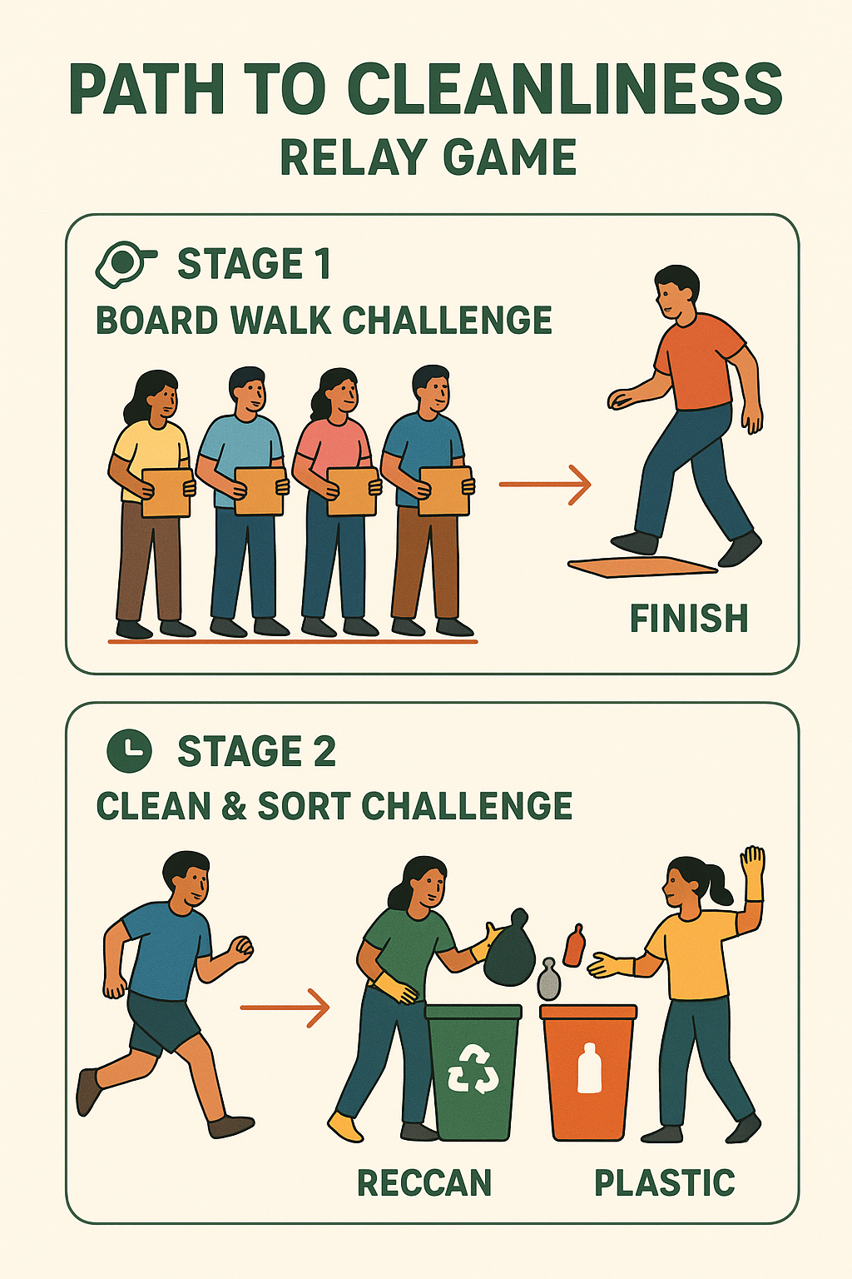
Path to Cleanliness – Relay Game Rules
Overview
This relay game has 2 stages.
Stage 1 focuses on teamwork and balance.
Stage 2 focuses on speed and correct waste sorting.
Stage 1: Board Walk Challenge
Players
Each team will have 5 players.
Teams will play one at a time.
How to Play
All 5 players stand in a line behind the starting line, each holding one board.
When the whistle blows, Player 1 places their board on the ground as far as possible and steps on it without touching the ground.
Then Player 2 does the same, placing their board in front and stepping on it.
This continues until all 5 players are standing on their boards.
Since boards are limited, players must share and move the last board to the front so the team can continue moving forward.
Teams must move without touching the ground and without holding onto each other or 1 point will be deducted from their total short game marks.
The stage ends when the last player crosses the finish line.
Stage 2: Clean & Sort Challenge
Players
Each team selects 3 players for Stage 2.
How to Play
Stage 2 begins as soon as the last player from Stage 1 crosses the finish line.
The 3 players run a short distance to reach the sorting area.
They must put on the given gloves.
Then they must separate the trash correctly into the dustbins provided.
Once all the trash is sorted, all 3 players must raise their hands together to stop the time.
Scoring
Teams will be judged based on:
Total time taken to finish both stages.
Correct sorting of trash into the right bins.

Slide 2
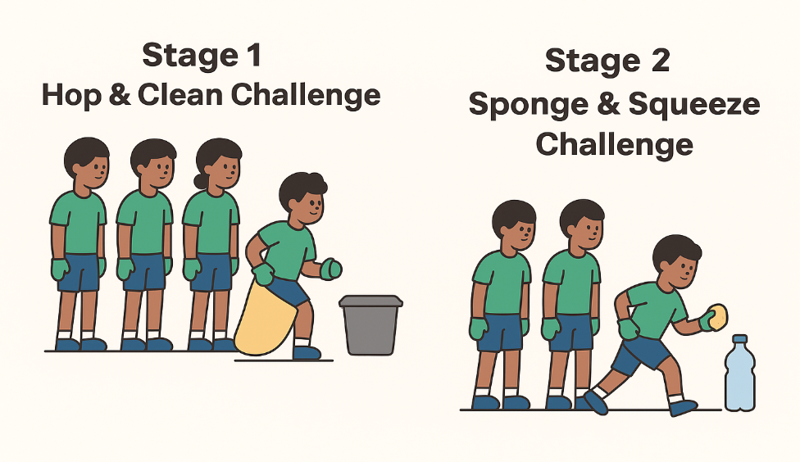
SpongeHop Relay – Game Rules
Overview
The SpongeHop Relay has 2 exciting stages.
Stage 1 focuses on hopping, collecting trash, and correct disposal.
Stage 2 focuses on teamwork, speed, and squeezing water into a bottle.
All teams will play both stages together.
Stage 1: Hop & Clean Challenge
Players
4 players per team.
All teams play at the same time.
All players must wear gloves.
How to Play
All 4 players stand in a line behind the starting line.
Player 1 holds the sack.
When the whistle blows, Player 1 must hop inside the sack to the marked point.
At the marked point, Player 1 picks up one piece of trash, then hops back.
Player 1 must throw the trash into the correct dustbin.
After throwing, they hop back across the starting line and give the sack to Player 2.
The same process continues for all players.
Important Rules
If the trash falls on the ground after the throw, it does NOT count.
If the sack tears, a new sack will be given, but the player must stay exactly where it tore.
Stage 1 lasts 2 Minutes.
If a team finishes early (all players completed their turn), Stage 2 will start only when the last player returns to the starting line.
Scoring for Stage 1
Points are given based on:
  How many trash items the team collected.
  How many were placed in the correct bin.

Slide 3
Stage 2: Sponge & Squeeze Challenge
Players
4 players.
All teams play together.
How to Play
Player 1 starts with the sponge in hand.
Player 1 runs to the bucket of water placed at a short distance.
They soak the sponge in the water.
Then they run back and squeeze the sponge water into the team’s bottle.
After squeezing, Player 1 passes the sponge to Player 2.
The process continues until the timer ends.
Time Limit
Stage 2 lasts 1 minute 30 seconds.
Scoring for Stage 2
Points are given based on:
How much water the team collects in the bottle.

